Slide 1
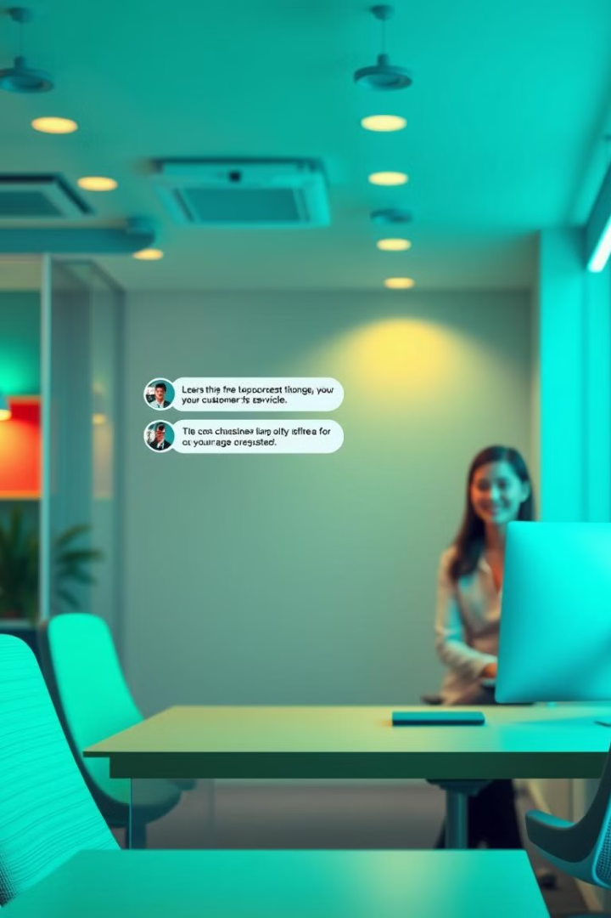

Chatbot and Virtual Assistant for Customer Service
This presentation explores the role of AI-powered chatbots and virtual assistants in enhancing customer service.
by ShaTech jsjk

Slide 2
Overview of Chatbots and Virtual Assistants
Chatbots
Virtual Assistants
AI-powered conversational agents that automate interactions with customers, typically text-based.
More advanced AI agents that handle complex tasks, offering personalized and proactive support, often with voice capabilities.

Slide 3
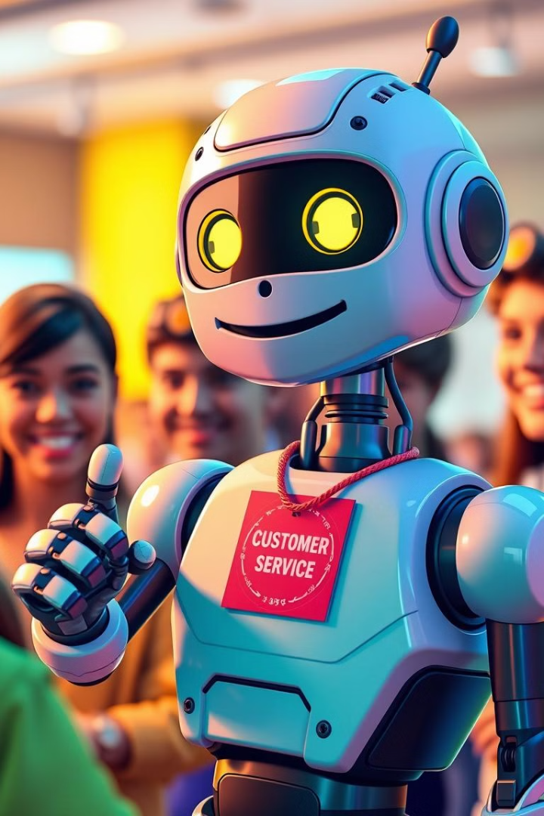
Benefits of AI-Powered Chatbots
1
24/7 Availability
2
Cost Savings
Chatbots can be accessed at any time, providing instant support.
Automating tasks reduces the need for human agents.
3
Improved Efficiency
4
Scalability
Chatbots handle repetitive tasks, freeing up human agents for more complex issues.
Chatbots can easily handle a surge in customer inquiries.

Slide 4
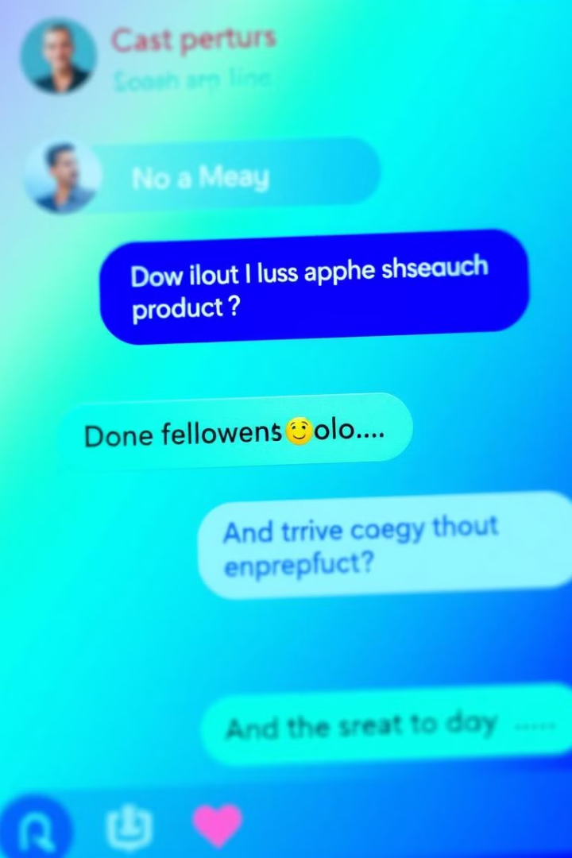




Key Features of Effective Customer Service Chatbots
Natural Language Processing (NLP)
Knowledge Base
A comprehensive database of information and responses for common customer inquiries.
Understanding and responding to human language in a conversational manner.
Personalization
Integration
Tailoring responses based on user history and preferences.
Connecting with other systems like CRMs and ticketing platforms for seamless support.

Slide 5
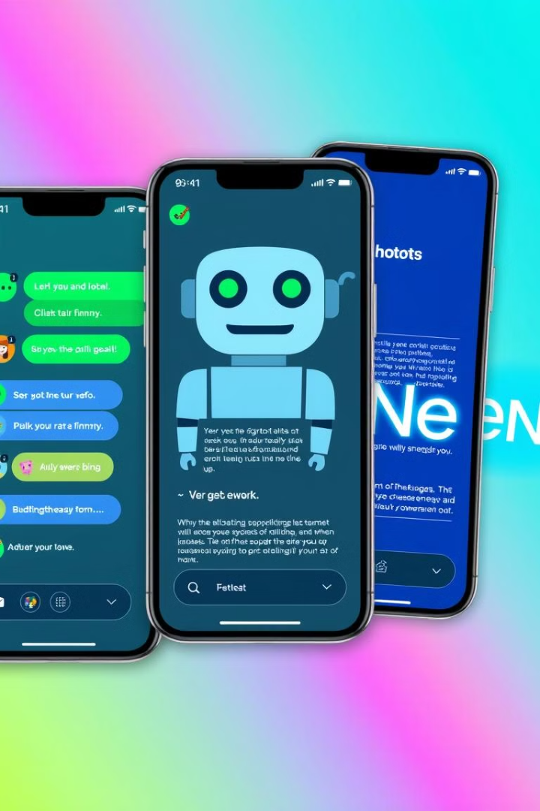
Comparison of Leading Chatbot Solutions
Solution
Strengths
Weaknesses
ChatGPT
Advanced NLP capabilities, excellent for open-ended conversations.
Can be prone to biases, requires careful training.
Google Dialogflow
Strong integration with Google products, user-friendly interface.
May be less flexible for complex workflows.
Microsoft Azure Bot Service
Scalability and enterprise-level features, robust security.
Steeper learning curve for non-technical users.

Slide 6
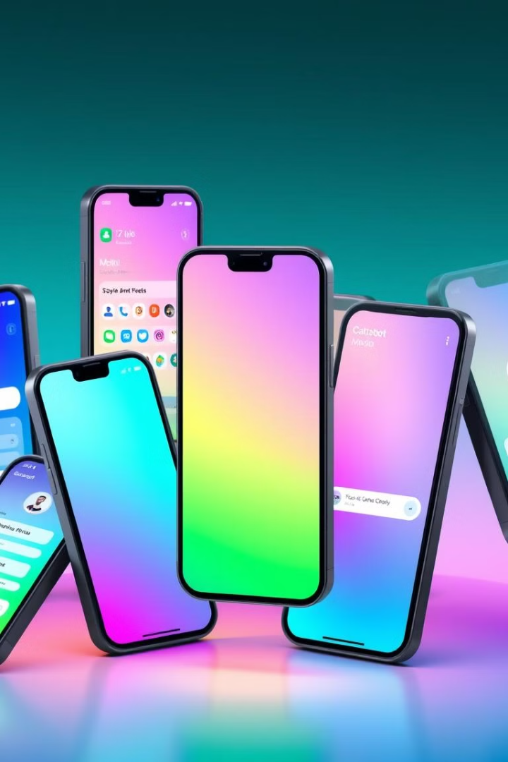
Examples of Successful Chatbot Implementations
Amazon
Starbucks
Uses chatbots for product recommendations and order tracking, enhancing customer engagement.
Offers chatbot-driven mobile ordering, providing a seamless and personalized experience.
Expedia
Leverages chatbots for travel planning and booking, assisting with flight and hotel reservations.

Slide 7
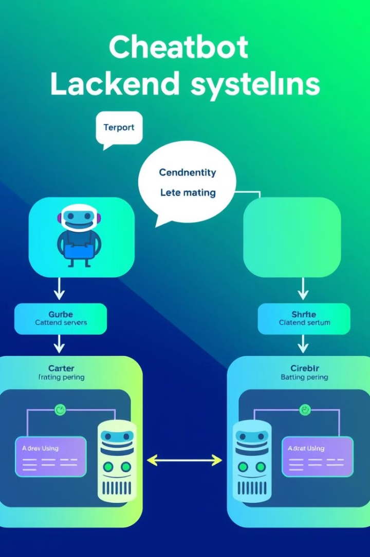



Integrating Chatbots with Backend Systems
Customer Interaction
Chatbot receives a customer inquiry.
Data Integration
Chatbot accesses relevant customer data from backend systems.
Personalized Response
Chatbot provides a personalized response based on integrated data.

Slide 8



Leveraging Machine Learning to Enhance Chatbots
Data Collection
1
Chatbot gathers data from interactions.
Model Training
2
Machine learning algorithms analyze data to improve accuracy.
Enhanced Response
3
Chatbot provides more accurate and relevant responses.

Slide 9
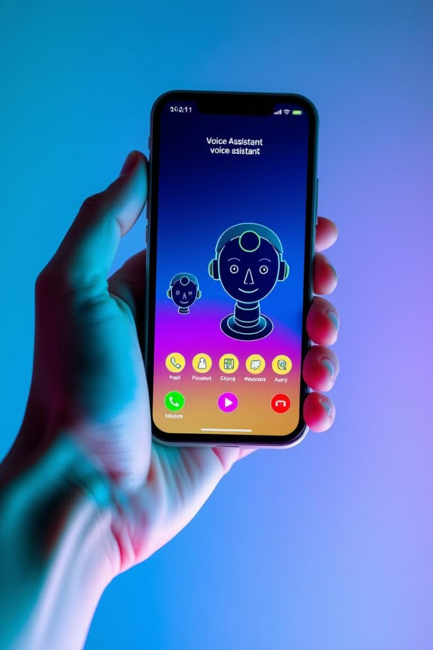
Conversational Interfaces and Voice Command Technology
1
Text-Based Chatbots
Early chatbots relied on text input for interaction.
2
Voice Interfaces
Chatbots evolve to accept voice commands, offering a more natural user experience.
3
Multimodal Interfaces
Future chatbots will combine text, voice, and visual elements for immersive interactions.

Slide 10
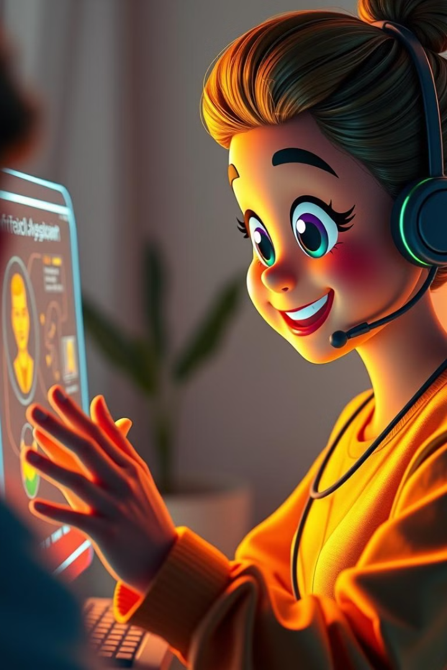
Implementing an AI Virtual Assistant
1
2
Define Goals
Choose Platform
Clearly outline the goals of the virtual assistant.
Select a suitable platform for your virtual assistant.
3
4
Train & Integrate
Deploy & Monitor
Train the AI and integrate it with existing systems.
Deploy the virtual assistant and monitor its performance.

